Slide 1
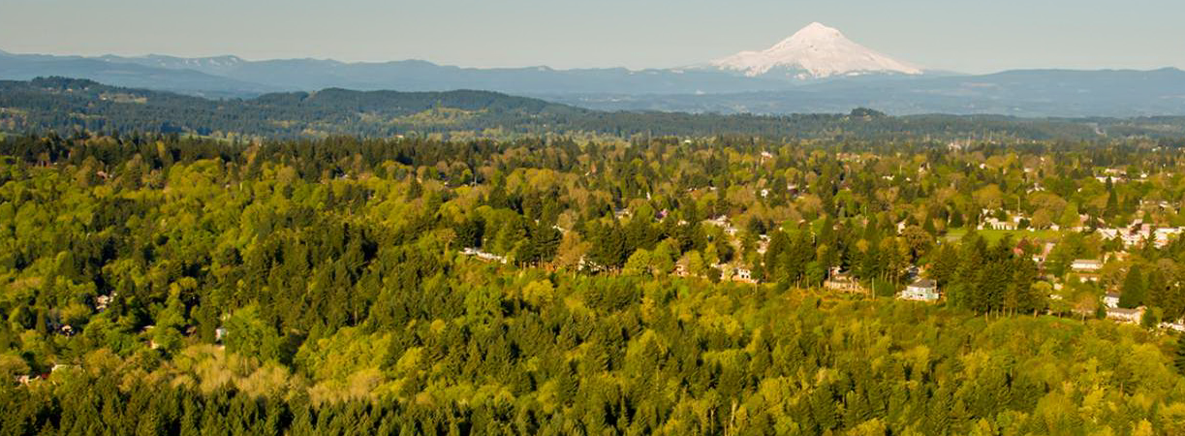
2030 Regional Waste Plan
Three-year Work Plans
Notes:
Good Morning and thank you for the opportunity to speak with you today. My name is Holly Stirnkorb and I am a Senior Planner with the Waste Prevention and Environmental Services Policy and Compliance Team. Today I will present the approach to develop the first, 3-year Work Plan to support implementation of the 2030 Regional Waste Plan.

Slide 2
Goals for today’s discussion
Inform committee
Create shared understanding of committee’s role
Prepare committee for input
Notes:
My goal for today’s discussion is to:
Inform you about the process to collaboratively develop the 3-year Work Plan.
Create a shared understanding of the role and responsibility of the committee in this process, including the timeline for key points of engagement
Prepare committee members for engagement in the first step of this process.

Slide 3
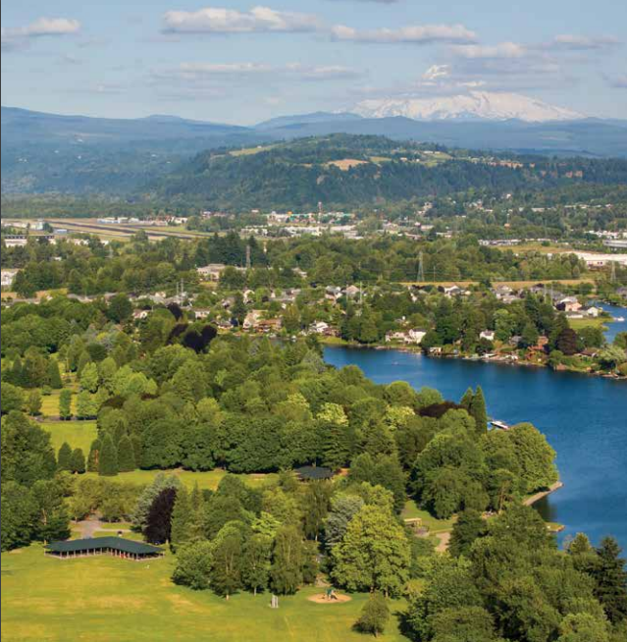
Role of Regional Waste Advisory Committee
Review and provide input on the actions and activities prioritized for implementation in the three-year regional work plan
Notes:
As you know, in March 2019, Metro adopted the 2030 Regional Waste Plan which sets the policy direction for the region’s garbage and recycling system. The 19 goals and one hundred and forty action in the plan provide a blueprint for the work to reduce the impacts of products throughout their lives, from production through disposal. In order to coordination implementation of these goals and actions over the life of the plan, Metro and local governments will work together to create work plans every three years.
The role of the Regional Waste Advisory Committee’s in this process is to review and provide input on the actions and activities that are prioritized for implementation in each three-year work plan.

Slide 4
Today’s presentation
Work plan purpose
Approach and timeline
RWAC role
Notes:
Today my presentation will include a little background on the purpose of the Work Plan in relationship to the 2030 Regional Waste Plan and then I will go into some detail about the process to develop the Work Plan including the approach, timeline and how the committee will be engage in Work Plan development.

Slide 5
2030 Regional Waste Plan Implementation
Metro Role
Coordinate implementation and monitor progress
00
Metro and Local Governments Roles
Lead or partner in implementation of goals and actions
Work Plans
Identify actions, roles and estimated resource allocations for initial implementation period
Notes:
First some background.
As I said, the Regional Waste Plan presents a blueprint for our work over the next 10 years to achieve the vision we set for the region.
In order to effectively implement the plan, Metro and local governments will work together to create work plans every three years. This project is about developing the first 3-Year Work Plan for fiscal years 2020 through 2023.
Responsibility for implementing the RWP is shared by Metro and city and county governments in the region.
Metro is responsible for coordinating implementation of the plan and assessing plan performance.
Actual implementation of the actions in the RWP are shared between local governments and Metro. Some actions will be led by local government, some will be led by Metro and the implementation of others with be co-led by both local government and Metro.
What the 3-Year Work Plans will do is identify actions to be implemented in each 3-year period, indicate which agency will lead the action and it will also proved the estimated resource allocations for the implementation period.
In a nutshell, the Work Plans break down implementation of the Regional Waste Plan into manageable pieces.

Slide 6
Regional Work Plan Inputs and Deliverables
Regional Work Plan Inputs and Deliverables
Metro WPES Regional Waste Plan Short Term Priorities
Local Government
Short Term Priorities
Working agreements
Funding agreements
Detailed project plans and scopes of work
Notes:
The work plan will be developed collaboratively with local governments every three years.
Both Metro and local government will be bringing their own priorities into the process as inputs to develop the work plan.
And the deliverables will not only consist of the work plan itself but also the agreements necessary to support implementation of the plan. These include agreements between Metro, local government and community partners to identify decision making processes, information sharing practices and scopes of work for funding allocations.
Our work with local governments over the next six months is to determine what we have the collective ability to accomplish within the next three years. Together, we will answer three questions:
What are the priority actions we will implement?
How will we resource these activities?
How will we work together to accomplish this?

Slide 7
Work Plan Inputs
Metro WPES Regional Waste Plan Short Term Priorities
Goals and Actions prioritized by:
Required responsibilities
Priorities set by Metro Council
Priorities identified in plan development by community members
Local Government
Short Term Priorities
Goals and Actions prioritized by:
Required responsibilities
Priorities set by city councils and county commissions
Priorities identified in plan development by community members
Notes:
A large number of the actions in the Regional Waste Plan represent guidance rather than requirements so timing for implementation will be determined by Metro and local governments
In order to prioritize the actions for the three-year work plan, both Metro and local government will be bringing their own short-term priorities into the process as inputs these include:
Required responsibilities: These are actions that are required by state law, Metro Code or Metro administrative rules and are primarily directed at ensuring that comprehensive and consistent recycling and garbage services are provided across the region. And these services are combined with the education, information and technical assistance programs needed to support residents and businesses in preventing waste, reusing materials and recycling.
There will be certain priorities for Metro that will be set by Metro Council and those for local governments that are set by city councils and county commissions.
And there are also priorities identified by community members in the process to develop the RWP.
The Regional Waste Advisory Committee will also provide input into the process as well.

Slide 8
Elements of the Work Plan
Regional Work Plan Inputs and Deliverables
Actions for implementation in the first three years
Description of activities
Roles for implementation
High level resource allocations to inform annual budgeting
Notes:
The priorities of both Metro and local government will shape the work plan by guiding the selection of actions for initial implementation in the first three years. Once actions have been selected, activities to implement each action will be crafted and included in the work plan along with the roles of each agency in implementing the action as well as an estimate of resources needed to implement the action.
As you all know, we are doing this at a time when our resources are tight and there are many demands and constraints on our staff time.
This opens up the opportunity to find new and innovative ways of working together. This can lead to additional efficiencies, increase our collaboration and strengthen our working relationships.

Slide 9
Agreements to Support Plan Implementation
Regional Work Plan Inputs and Deliverables
Working agreements
Funding agreements
Detailed project plans and scopes of work
Notes:
Once the work plan has been developed we will craft working agreements necessary to support implementation of the plan. These include agreements between Metro, local government and community partners to identify decision making processes, information sharing practices and scopes of work for funding allocations.

Slide 10
Work Plan Concept
Goal 1: Increase engagement of youth and adults historically marginalized from garbage
and recycling decision-making by enhancing civic engagement and leadership opportunities.
 |  |  | LEAD | IMPLEMENTATION | METRO | LOCAL GOVERNMENT | ESTIMATED RESOURCE NEEDS
 | ACTIONS |  | AGENCY | APPROACH | PLANNED ACTIVITIES | PLANNED ACTIVITIES | FY 20-21 | FY 21-22 | FY 22-23
1.1 | Increase representation of historically marginalized community members, including youth, on advisory committees, such as Metro and local government solid waste advisory committees. | E N | Metro Cities Counties | Code and Authorizations | Convene new composition of the Regional Waste Advisory Committee. | Reform Solid Waste Advisory Committee to include more equitable representation and trauma informed practices (include youth representation). | Staff $ | Staff $ | Staff $
Notes:
This is a concept of what the Work Plans might look like for a particular goal and action.
The Work Plan will
Be high level and organized by Regional Waste Plan goal areas
It will list each identified goal and prioritized action for implementation in the 3-year period
Indicate the lead agency for each action – it is led my Metro, by local government or co-led
Indicate the implementation approach
Identify high level activities to implement the action
And list estimated resource needs to accomplish the activities.

Slide 11
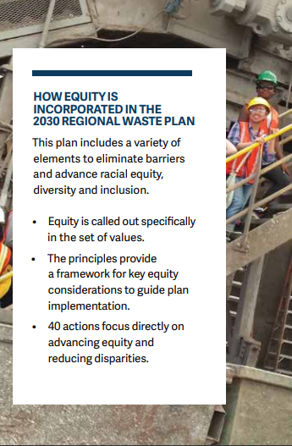
Equity guides plan implementation
Input from Regional Waste Advisory Committee
Participation of community members and community-based organization
Notes:
The Regional Waste Plan includes a variety of elements to eliminate barriers and advance racial equity, diversity and inclusion. Equity is called out in a set of values. And a set of principles provide a framework for key equity considerations to guide plan implementation. 40 actions in the RWP focus directly on advancing equity and reducing disparities.
This commitment to equity will guide the development of the work plan. We will seek input from the Regional Waste Advisory Committee and we will also involved the community-based organizations that helped shape equity focused actions, as needed, in the development of the activities to implement actions.

Slide 12
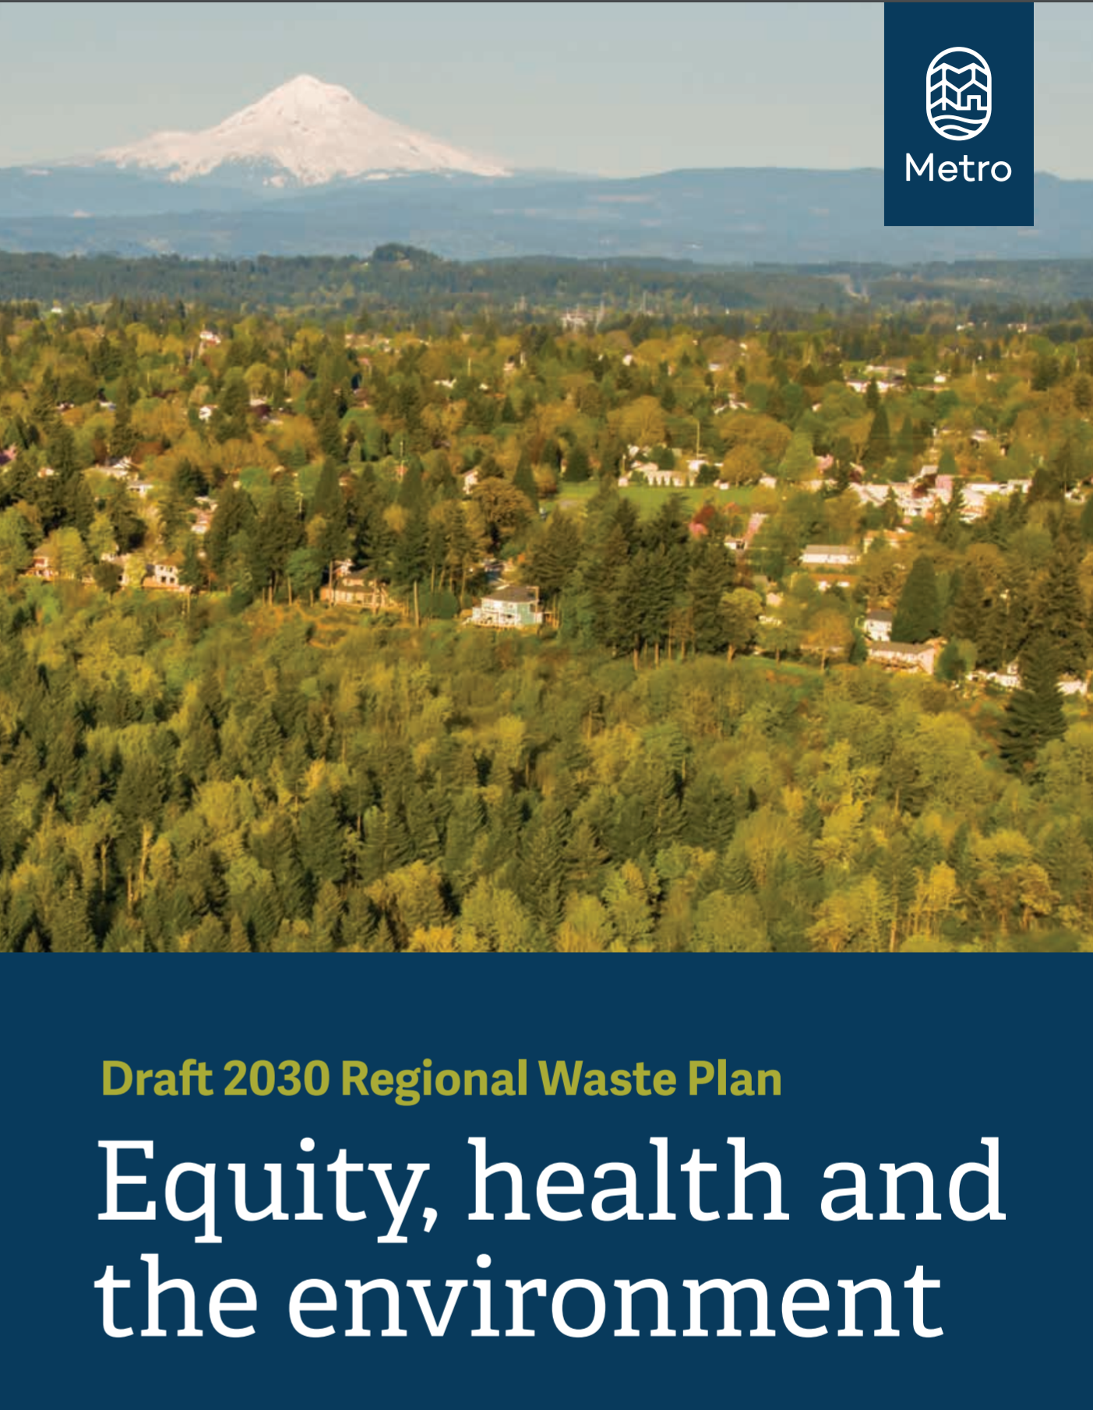
Work Plan Purpose
Identify priority actions
Identify roles for action implementation
Estimate resource needs to inform budgeting
Develop implementation agreements
12
Notes:
The process to develop the 3-Year Work Plan will be collaborative.
It will include local government and Metro staff as well as external stakeholders including the community based organization that helped shape the RWP.
Our goal in crafting this process is to create shared ownership of the work plan. We want to create:
Shared agreement of the actions we prioritize for implementation in these first 3 years
Shared understanding of agency roles and responsibilities including how the work associated with implementing the prioritized actions aligns with our current work including identification of resource needs and gaps.
We also plan to co-develop new, or refine existing agreements with local government and community partners necessary to support implementation of the plan including decision making processes, information sharing practices and scopes of work for funding allocations.
In short, we want to create a plan we can all get behind in order to set the stage for successful outcomes.
Throughout the process we will use tools to ensure that we maintain focus on racial equity.
And finally we will document the planning process and create a roadmap to make it easier to develop subsequent three-year plans.

Slide 13
Regional FY 20-23 Work Plan Process and Timeline
WE ARE HERE
PHASE 2
Develop Work Plan
PHASE 3
Finalize Implementation Agreements
PHASE 1
Identify Plan Actions
Aug 2020- Dec 2020 | Dec 2020- Feb 2020 | Feb 2021- April 2021
Draft action list RWAC review and input | Draft work plan RWAC review and input Final work plan | Decision-making & information sharing agreements RWAC update
Notes:
This project has three phases and is anticipated to take 8 months from start to finish.
The first phase began in late July with the design of the approach to the planning process and moved into working with local governments to identify actions for implementation for the first three years.
The second phase with begin in December and will focus on drafting the work plan. The draft plan will include the actions identified for implementation, high-level activities to implement each action, agency and community partner roles in implementation and an estimate of resource needs. To inform work plan development, work groups will be convened that include staff from Metro and local governments in addition to community based organizations partnered on action implementation.
The Regional Waste Advisory Committee will be asked for feedback on the identified actions in Phase 1 as well as the work plan in Phase 2.
The third phase will focus on finalizing agreement to support implementation of the Work Plan.
The third and final phase will begin in February 2021 with the goal to complete the 3-Year Work Plan and all the supporting agreements by early 2021.

Slide 14
Regional Waste Advisory Committee Phase 1 Engagement Timeline
Regional Waste Advisory Committee Engagement | Timeline
Informational presentation to committee on process | Oct 15 RWAC Meeting
List of prioritized actions distributed to committee | Oct 30
Assistance provided to community members | Nov 2-6
Online survey to solicit input on questions provided | Distributed Oct 30 Due Nov 12
Solicit input from committee | Nov 19 RWAC Meeting
Information presentation to committee on final actions | Dec 17 RWAC Meeting
Notes:
Metro staff will engage the Regional Waste Advisory Committee throughout development of the work plan for continued guidance and to provide informational updates. The full schedule of engagement is included in the memo that was provided to the committee with an overview of the project.
Now, I would like to spend a few minutes to detail the schedule for engagement in the first phase of the project. The first phase of the project is to identify actions for implementation for the three-year work plan, including agency roles and responsibilities for action implementation. The role of the Regional Waste Advisory Committee during this phase of the project is to provide input on actions prioritized for the first three years.
Today we provided you with an informational presentation to familiarize you with the process to develop the three-year plan.
On October 30th we will provide you with the list of actions prioritized for implementation by Metro and local governments for review.
To facilitate your review and input we will do two things:
First we will conduct a survey. The email on October 30th with the list of actions will include a link to a survey. We would like each of you to respond to the survey by November 12.
Second, we’d like to support the community members of the committee in their review of the actions by offering one-on-one time with staff to answer questions or clarify issues prior to the November 19 committee meeting. We will reach out to you the week of November 2nd to see if you want to schedule a call.
At the November 19th committee meeting we will report on your responses to the survey and facilitate a discussion to gather additional input to inform the action prioritized for the three-year work plan. And finally on December 19th we will present the final actions and describe how committee input was incorporated. We will also provide an update on the progress of the project.

Slide 15
Regional Waste Advisory Committee Considerations
Which actions were not included that should be? Why?
Which actions were included that should not be? Why?
Which actions should the Regional Waste Advisory Committee have continued engagement?
Notes:
Thinking about the next three years of the work plan, we’d like the committee’s input on what was not included in the list and actions that you would like to see implemented in the short term or what was included that you think should be postponed, and why.
Questions for consideration include:
Which actions were not included that should be? Why?
Which actions were included that should not be? Why?
Which actions should the Regional Waste Advisory Committee have continued engagement?

Slide 16
Discussion Questions
Do you have any questions on the process or timeline?
Do you have an questions on RWAC’s role?
Notes:
That concludes my presentation and I like to open it up for questions.

