Slide 1
2030 Regional Waste Plan
Three-year Work Plans
Notes:
Good Morning my name is Holly Stirnkorb and I am a Senior Planner with the Waste Prevention and Environmental Services Policy and Compliance Team.
I am here today to gather your input on the draft list of actions prioritized for the first 3-year work plan to support implementation of the 2030 Regional Waste Plan.

Slide 2
Today’s discussion
Survey results
Address questions from the survey
Gather additional input
Notes:
Share the results of the online survey that we ask you to participate in
Address questions submitted as part of the survey and clarify an issue that came up for several folks in the survey
And then have a discussion to gather additional input

Slide 3
Role of Regional Waste Advisory Committee
Review and provide input on the actions and activities prioritized for implementation in the three-year regional work plan
Notes:
As we discussed in October, Metro and local government partners are collaboratively developing a three-year work plan to support implementation of the 2030 Regional Waste Plan. The work plan will prioritize actions for implementation in years one through three of the Regional Waste Plan; identify high-level activities to achieve each action; and include estimates of resources needed to complete the work which will inform Metro and local government budgeting and resource allocation decisions.
The role of the Regional Waste Advisory Committee’s in this process is to review and provide input on the actions and activities that are prioritized for implementation in each three-year work plan.

Slide 4
Committee Input
Which actions were not included that should be? Why?
Which actions were included that should not be? Why?
Which actions should the Regional Waste Advisory Committee have continued engagement?
Notes:
The first phase of the project is to identify actions for the 3-year work plan, including agency roles and responsibilities for action implementation. On October 30th the committee was provided with the list of actions prioritized for implementation by Metro and local governments for review. To facilitate review and input, Metro staff conducted an online survey and community members of the committee were offered one-on-one time with staff to answer questions or clarify issues prior to today’s committee meeting.
The committee is being asked to think about the next three years of the work plan, and provide input on what was not included in the list of actions that the committee would like to see implemented in the short term or what was included that should be postponed, and why. Questions for consideration include:
Which actions were not included that should be? Why?
Which actions were included that should not be? Why?
Which actions should the Regional Waste Advisory Committee have continued engagement?

Slide 5
Color Coding
Dark Green – Shared priority actions for Metro and all local governments
Light Green – Actions prioritized by either Metro or one or more local governments
Unshaded – Actions that were not prioritized for this work plan and that will be considered for future work plans
Notes:
Before I get into the results of the survey, I’d like to clarify how we color coded the actions for your review.
Some actions were shaded dark green, other were light green and others were unshaded.
I want to make it clear is that the shading did not have to do with ranking the actions by level of importance, rather the shading has more to do with how Metro and cities and counties will work together to implement the actions.

Slide 6
Lead Agencies
Regional Work Plan Inputs and Deliverables
Co-led: by Metro and cities and counties. Agencies will collaborate to coordinate planning and implementation
Local Government-Led: Cities and counties collaborate to coordinate planning and implementation
Metro-Led: Metro is responsible for planning and implementation
Notes:
Successful implementation of the actions will require collaboration and coordination among Metro, local governments, community-based organizations and private sector service providers. To assist with implementation and accountability, the Regional Waste Plan identifies lead agencies for each action, some actions are co-led by Metro and cities and counties, meaning that Metro and local governments will collaborate to coordinate planning and implementation. Others actions will be led by cities and counties. Cities and counties will collaborate to coordinate planning and implementation. And others are led by Metro, meaning that Metro is responsible for planning and implementing the action.

Slide 7
Example Co-Led Action Prioritized by all agencies
Notes:
So the shading has to do with how we are working together to implement the actions.
The dark green actions are all co-led actions that all the agencies agreed to prioritize for this work plan.
An example is Action 6.5 to assist households and businesses in the adoption of practices that prevent the wasting of food and other high-impact materials. Metro and all the cities and counties have agreed to implement this action in this 3-year work plan.

Slide 8
Example Co-Led Action Prioritized by combination of agencies
Notes:
There are co-led actions that are light green. These have been prioritized by some combination of Metro and local governments but not all agencies are able to commit to the action in the next three years. The shading indicates that progress will be made at an individual agency level to implement these actions and that additional agencies may commit to implementation in future work plans.
An example is Action 7.1 related to procurement policies that prioritize purchase of products and services with low environmental and human health impacts. Metro and several cities will implement this action in the work plan and several other cities have indicated that they will prioritize the action in the next three year work plan.

Slide 9
Example Local Government-Led Action
Notes:
There are actions shaded in light green that are led by local governments. These are actions that Cities and counties will collaborate to coordinate planning and implementation.
Action 6.7 is an example of a local government led program to provide recognition for business efforts to prevent waste and minimize the environmental impacts of the products they purchase.

Slide 10
Example Metro-Led Action
Notes:
And finally there actions shaded in light green that are the responsibility of Metro to plan and implement such as action 16.1 which relates to the Metro West transfer station that you have been hearing about.
In short, anything shaded is going to be worked in the next three years. The difference is how we are working together to implement the actions.

Slide 11
Survey Key Takeaways
Most respondents did not perceive actions were missing
No specific actions were recommended for removal
No consensus on actions the committee should continue to engage in
Some agreement that equity should remain a focus of the committee
Sub-committees were suggested to accommodate the varied interests
Notes:
So now I’d like to move onto the survey results.
As I mentioned we asked committee members to complete an online survey to gather input on what was not included in the list of actions that the committee would like to see implemented in the short term, what was included that should be postponed, and what the committee would like to remain engaged in.
Seven committee members responded to the survey and these are the key takeaways:
Most respondents did not perceive that there are actions missing. However, local governments did identify the need to coordinate on disaster resilience actions. I will touch on that in a minute.
No specific actions were recommended for removal
No consensus on actions the committee should continue to engage in
Some agreement that equity should remain a focus of the committee
Sub-committees were suggested to accommodate the varied interests

Slide 12
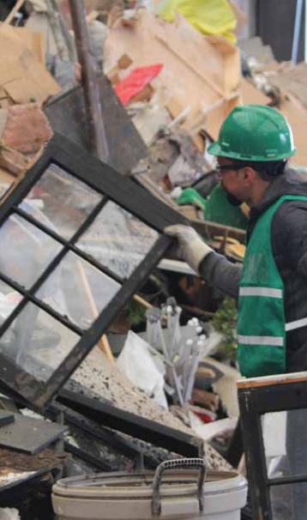
Disaster Resilience
17.2 Conduct periodic exercises to test and practice the implementation of disaster debris plans
18.2 Implement requirements for solid waste system service providers to prepare and maintain emergency operations and continuity of operations plans
19.3 Develop agreements and contracts with service providers and partner jurisdictions to ensure rapid mobilization of regional and out-of-region resources during emergency response operations
Notes:
Regarding disaster resilience, in our work session with local governments to prioritize actions, the need to focus on disaster resilience in this 3-year work plan was identified. As a result, Metro will begin to work with local governments to identify activities to implement the following three actions:
17.2. Conduct periodic exercises to test and practice the implementation of disaster debris plans
18.2 Implement requirements for solid waste system service providers to prepare and maintain emergency operations and continuity of operations plans.
19.3 Develop agreements and contracts with service providers and partner jurisdictions to ensure rapid mobilization of regional and out-of-region resources during emergency response operations.

Slide 13
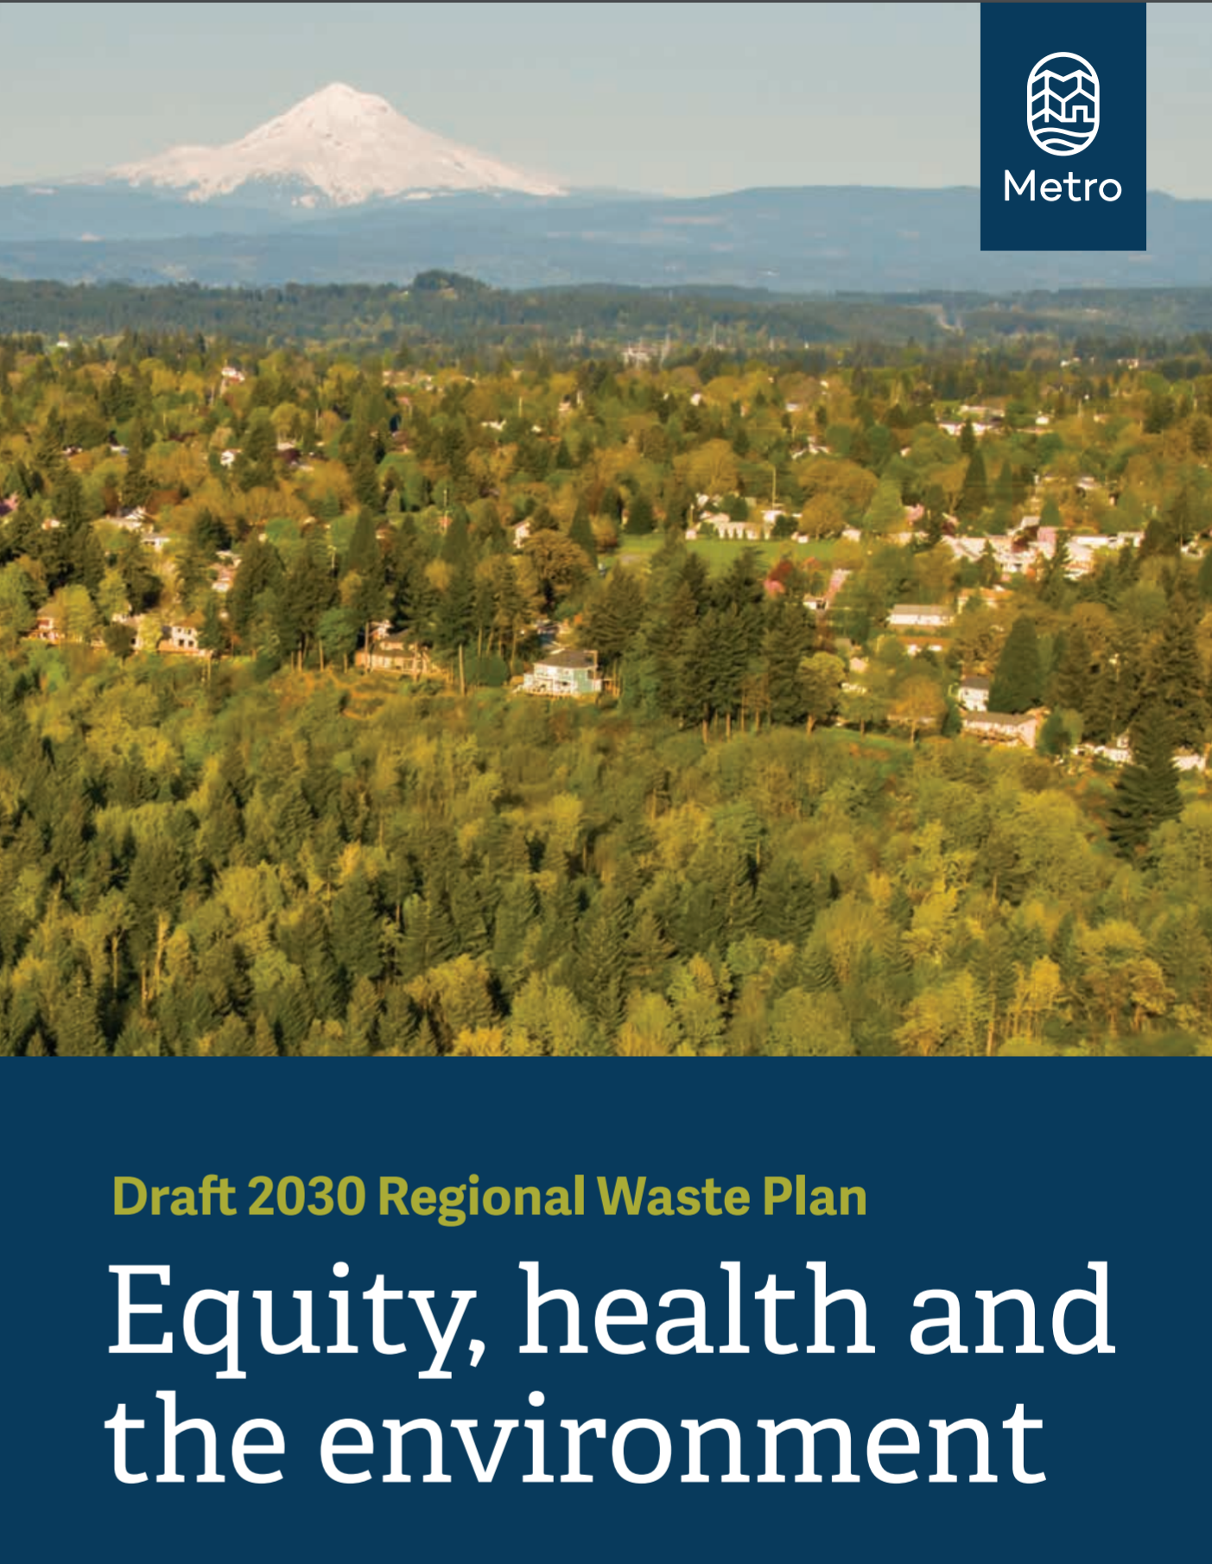
Questions from the Survey
Educate consumers on ways to reduce the harmful impacts of products throughout their full life cycle
Evaluate progress towards the vision and goals in the plan
12
Notes:
There were several questions listed in the survey. I’d like to address a few of those before opening up the discussion for general input.
There were a few questions that related to educating consumers on ways to reduce the harmful impacts of products throughout their full life cycle including how to shift the focus from end of life – what to do with a product that has already been purchased, or not have good choices in the first place – to helping folks advocate for changing the choice of products made available them in order to reduce impacts.
Taken as a whole, the goals and actions in the plan address every stage of the product life cycle from design and manufacture to disposal. In many cases, the actions complement each other to accomplish certain goals - and they address issues from different fronts. So while educating consumers to advocate for changing the choices made available to them is included in many of the existing education programs. The work plan also includes actions that involve legislative efforts and assistance in implementing existing laws focused on influencing product choices available to consumers. These actions include advocating for product stewardship legislation, eco-modulated fees which is part of product stewardship and are fees that provide incentives for producers to minimize the use of chemicals of concern. And there are also actions that provide support to implementing the Oregon Toxic-Free Kids Act which requires manufactures of children’s products sold in Oregon to report products containing chemical of concern.
There were also questions about how we will evaluate progress towards the vision and goals in the plan.
The plan includes a measurement framework to evaluate progress. The measurement framework identifies three types of indicators including Key Indicators, Goal Indicators and Performance Indicators. Some of the data to inform the indicators is available like tons of waste generated. Other indicators will require collecting new data. Please refer to the Measuring Progress chapter of the Regional Waste Plan for a description of each type of indicator. Metro is in the process of developing a concept for an annual Regional Waste Plan report that will track progress towards implementing plan actions and meeting indicators.
Goal 15: How are community needs assessed? - anywhere in this plan - who would lead? Are these community led?
General questions around how this plan is communicated to community? How to break down a 30 -year plan in 3- year work plans. What does that mean for community engagement? How is outreach done to ensure communities receive this information?
Action 15.10: Does this action represent an opportunity to evaluate and design a new model for funding waste prevention work, de-coupled from waste collection rates?
Goal 16: Which actions promote small recycling and reuse depots? Not clear to me.

Slide 14
Regional Waste Advisory Committee Considerations
Which actions were not included that should be? Why?
Which actions were included that should not be? Why?
Which actions should the Regional Waste Advisory Committee have continued engagement?
Notes:
Now I would like to open it up to additional input. Roy will invite each of you to provide input. As a reminder we are asking you to think about the next three years of the work plan, and provide input on what was not included in the list of actions that you would like to see implemented in the short term or what was included that you think should be postponed, and why.
Questions for consideration include:
Which actions were not included that should be? Why?
Which actions were included that should not be? Why?
Which actions should the Regional Waste Advisory Committee have continued engagement?

Slide 15
Regional Waste Advisory Committee Phase 1 Engagement Timeline
Regional Waste Advisory Committee Engagement | Timeline
Informational presentation to committee on process | Oct 15 RWAC Meeting
List of prioritized actions distributed to committee | Oct 30
Assistance provided to community members | Nov 2-6
Online survey to solicit input on questions provided | Distributed Oct 30 Due Nov 12
Solicit input from committee | Nov 19 RWAC Meeting
Information presentation to committee on final actions | Dec 17 RWAC Meeting
Notes:
Thank you so much for your time in completing the online survey and your input today.
Metro staff will continue engage the Regional Waste Advisory Committee throughout development of the work plan for continued guidance and to provide informational updates. The full schedule of engagement was included in the memo that was provided to the committee with an overview of the project in October.
The next point of engagement with the committee for Phase 1 of this project will be on December 17th when will present the final actions and describe how committee input was incorporated. We will also provide an update on the progress of the project.

